Slide 1
SWING
Курс Java2. Лавринов Сергей

Slide 2
SWING, AWT
AWT
Каждому графическому компоненту ставится в соответствие компонент ОС.
SWING
Компоненты рисуют сами себя. Выглядят одинаково под разными ОС.

Slide 3
Основные компоненты:
public class A extends Jframe (JPanel) {
JFrame frame = new JFrame("Demo");
frame.setDefaultCloseOperation(JFrame.EXIT_ON_CLOSE);
//Create and set up the content pane.
BoxAlignmentDemo newContentPane = new BoxAlignmentDemo();
newContentPane.setOpaque(true); //content panes must be opaque
frame.setContentPane(newContentPane);
//Display the window.
frame.pack();
frame.setVisible(true);
}

Slide 4
try {
//UIManager.setLookAndFeel("com.sun.java.swing.plaf.windows.WindowsLookAndFeel");
UIManager.setLookAndFeel("javax.swing.plaf.metal.MetalLookAndFeel");
} catch (UnsupportedLookAndFeelException ex) {
ex.printStackTrace();
} catch (IllegalAccessException ex) {
ex.printStackTrace();
} catch (InstantiationException ex) {
ex.printStackTrace();
} catch (ClassNotFoundException ex) {
ex.printStackTrace();
}

Slide 5
Java layouts:
BorderLayout
BoxLayout
CardLayout
FlowLayout
GridBagLayout
GridLayout
GroupLayout
SpringLayout

Slide 6
BorderLayout
Только 5 компонетов:
...//Container pane = aFrame.getContentPane()...
JButton button = new JButton("Button 1 (PAGE_START)");
pane.add(button, BorderLayout.PAGE_START);
//Make the center component big, since that's the //typical usage of BorderLayout. button = new JButton("Button 2 (CENTER)"); button.setPreferredSize(new Dimension(200, 100));
pane.add(button, BorderLayout.CENTER);
button = new JButton("Button 3 (LINE_START)");
pane.add(button, BorderLayout.LINE_START);
button = new JButton("Long-Named Button 4 (PAGE_END)"); pane.add(button, BorderLayout.PAGE_END);
button = new JButton("5 (LINE_END)"); pane.add(button, BorderLayout.LINE_END);

Slide 7
BorderLayout
Конструктор:
Constructor BorderLayout(int horizontalGap, int verticalGap)

Slide 8
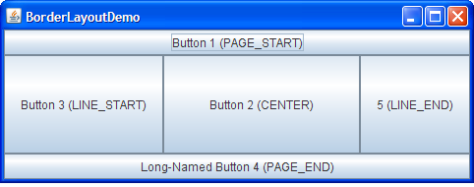
BoxLayout

Slide 9
BoxLayout
Creating BoxLayout Objects Constructor BoxLayout(Container, int)
Creates a BoxLayout instance that controls the specified Container. The integer argument specifies the axis along which the container's components should be laid out. When the container has the default component orientation, BoxLayout.LINE_AXIS specifies that the components be laid out from left to right, and BoxLayout.PAGE_AXIS specifies that the components be laid out from top to bottom.
Box(int) Creates a Box — a container that uses a BoxLayout with the specified axis. static Box createHorizontalBox() (in Box) Creates a Box that lays out its components from left to right. static Box createVerticalBox() (in Box) Creates a Box that lays out its components from top to bottom.

Slide 10
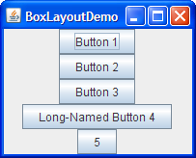
BoxLayout

Slide 11
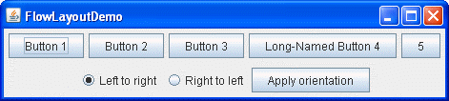
FlowLayout

Slide 12
Flow layout
The following table lists constructors of the FlowLayout class.
Constructor FlowLayout()
Constructs a new FlowLayout object with a centered alignment and horizontal and vertical gaps with the default size of 5 pixels.
FlowLayout(int align)
Creates a new flow layout manager with the indicated alignment and horizontal and vertical gaps with the default size of 5 pixels. The alignment argument can be FlowLayout.LEADING, FlowLayout.CENTER, or FlowLayout.TRAILING. When the FlowLayout object controls a container with a left-to right component orientation (the default), the LEADING value specifies the components to be left-aligned and the TRAILING value specifies the components to be right-aligned.
FlowLayout (int align, int hgap, int vgap)
Creates a new flow layout manager with the indicated alignment and the indicated horizontal and vertical gaps. The hgap and vgap arguments specify the number of pixels to put between components.

Slide 13
GridBagLayout

Slide 14
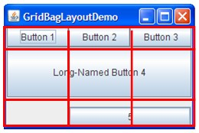
GridBagLayout

Slide 15
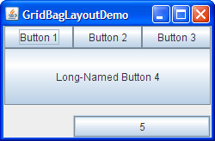
GridBag Layout

Slide 16
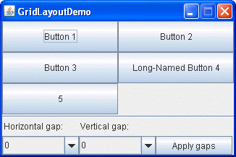
GridLayout
Constructor GridLayout(int rows, int cols)
reates a grid layout with the specified number of rows and columns. All components in the layout are given equal size. One, but not both, of rows and cols can be zero, which means that any number of objects can be placed in a row or in a column.
GridLayout(int rows, int cols, int hgap, int vgap) Creates a grid layout with the specified number of rows and columns. In addition, the horizontal and vertical gaps are set to the specified values. Horizontal gaps are places between each of columns. Vertical gaps are placed between each of the rows.

Slide 17
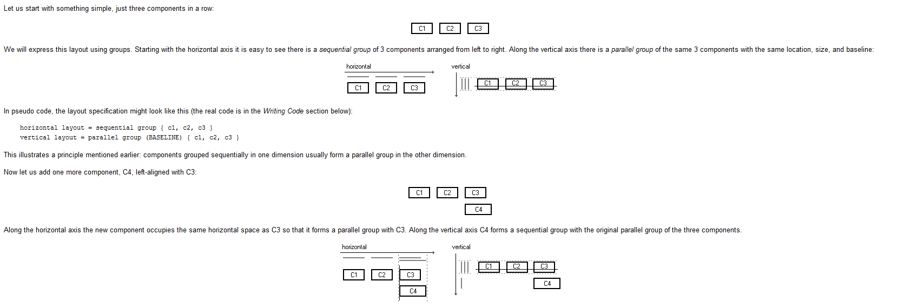
Group Layout

Slide 18
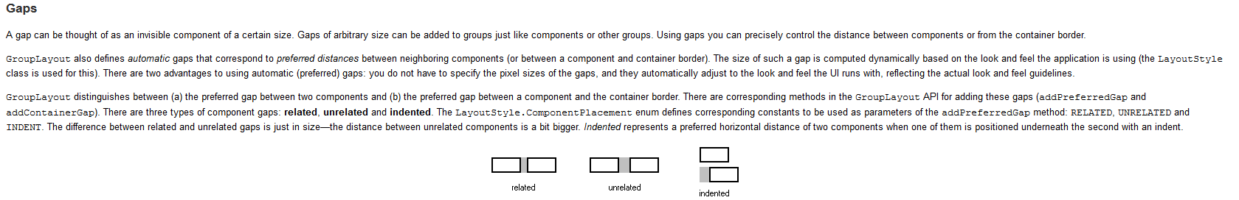
Group Layout

Slide 19

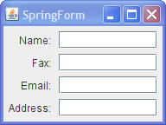
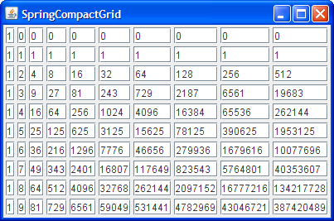
Spring Layout

Slide 20
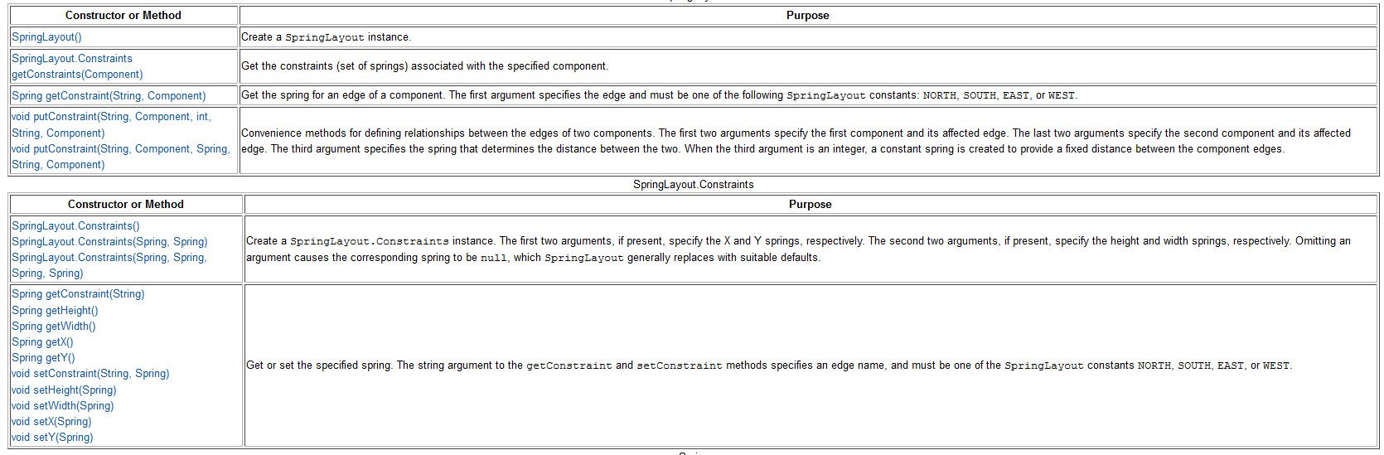
Spring Layout

Slide 21
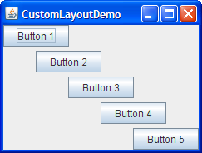
Custom Layout
Пример: Diagonal Layout

